Slide 1
Lecture 2
Abrar Hasan
Lecturer
Department of Software Engineering
Daffodil International University

Slide 2
Exception Handling & Collection Framework

Slide 3
What is Exception
In Java, Exception is an unwanted or unexpected event, which occurs during the execution of a program, i.e. at run time, that disrupts the normal flow of the program’s instructions.
Exceptions can be caught and handled by the program.
When an exception occurs within a method, it creates an object.
This object is called the exception object.

Slide 4
Major reasons why an exception occurs:
Invalid user input
Device failure
Loss of network connection
Physical limitations (out-of-disk memory)
Code errors
Opening an unavailable file

Slide 5
Difference between Error and Exception
Error: An Error indicates a serious problem that a reasonable application should not try to catch.
Exception: Exception indicates conditions that a reasonable application might try to catch.

Slide 6
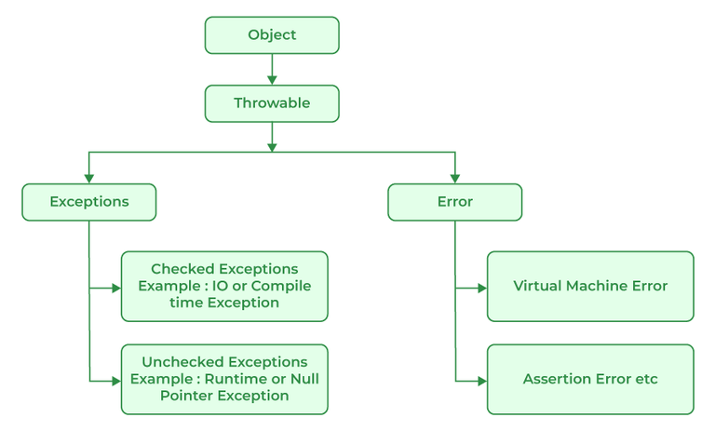
Exception Hierarchy

Slide 7
Exception Example
import java.io.*;
class GFG {
public static void main (String[] args) {
int a=5;
int b=0;
try{
System.out.println(a/b);
}
catch(ArithmeticException e){
e.printStackTrace();
}
}
}
Output
java.lang.ArithmeticException: / by zero
at GFG.main(File.java:10)

Slide 8
Java try…..catch Block
The try-catch block is used to handle exceptions in Java. Here's the syntax of try...catch block:
try {
// code
}
catch(Exception e) {
// code
}

Slide 9
Example: Exception handling using try...catch
class Main {
public static void main(String[] args) {
try {
// code that generate exception
int divideByZero = 5 / 0;
System.out.println("Rest of code in try block");
}
catch (ArithmeticException e) {
System.out.println("ArithmeticException => " + e.getMessage());
}
}
}
Output:
ArithmeticException => / by zero

Slide 10
Java finally Block
In Java, the finally block is always executed no matter whether there is an exception or not.
The finally block is optional. And, for each try block, there can be only one finally block.
try {
//code
}
catch (ExceptionType1 e1) {
// catch block
}
finally {
// finally block always executes
}

Slide 11
Example: Java Exception Handling using finally block
class Main {
public static void main(String[] args) {
try {
// code that generates exception
int divideByZero = 5 / 0;
}
catch (ArithmeticException e) {
System.out.println("ArithmeticException => " + e.getMessage());
}
finally {
System.out.println("This is the finally block");
}
}
}
Output:
ArithmeticException => / by zero
This is the finally block

Slide 12
Custom Exception
Create CustomException Class
Extend Exception Class
Use throw keyword to raise an exception

Slide 13
Collection in Java
The Collection in Java is a framework that provides an architecture to store and manipulate the group of objects.
Java Collections can achieve all the operations that you perform on a data such as searching, sorting, insertion, manipulation, and deletion.

Slide 14
Framework in Java
It provides readymade architecture.
It represents a set of classes and interfaces.
It is optional.

Slide 15
What is Collection Framework
The Collection framework represents a unified architecture for storing and manipulating a group of objects. It has:
Interfaces and its implementations, i.e., classes
Algorithm

Slide 16
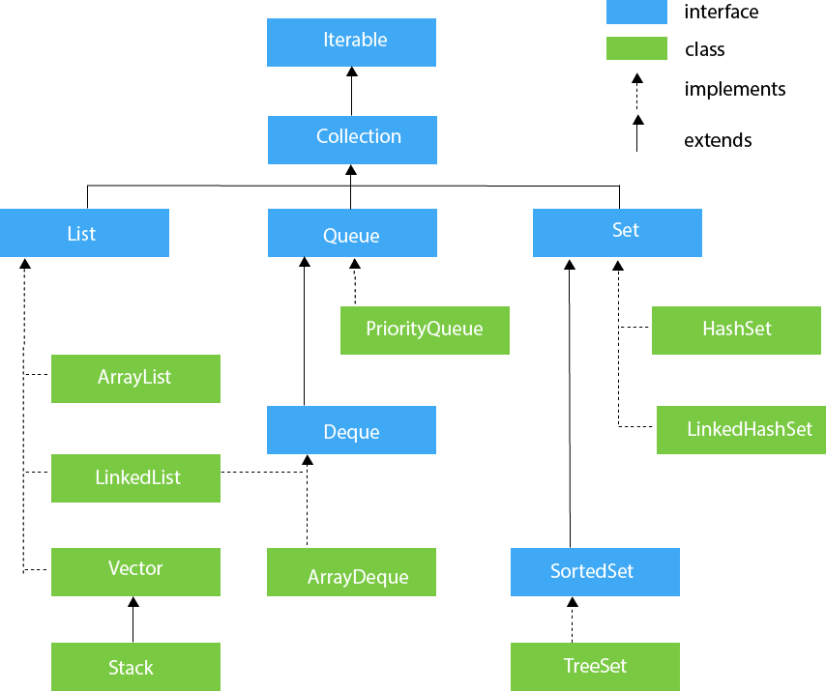
Hierarchy of Collection Framework

Slide 17
Classwork
Suppose you have to build a list of price of the Items in a super shop. The user will enter the index and your program will print the price of that item. Now Create a custom Exception Class and check if the user has entered any index which is not present.
Example:
{1,120,23, 11}
User Input: 1
Output : 120
User Input: 10
Output : Exception: WRONG INDEX

Slide 18
References
https://www.programiz.com/java-programming/exception-handling
https://www.javatpoint.com/collections-in-java
https://www.javatpoint.com/exception-handling-in-java

Slide 19
Thank You

